Slide 1
Collaborative Filtering in Social Tagging System on Joint Item-Tag Recommendations
Date : 2011/11/7
Source : Jing Peng et. al (CIKM’10)
Speaker : Chiu I- Chih
Advisor : Dr. Koh. Jia-ling

Slide 2
Outline
Introduction
Unified User Profiling
Joint Item-Tag Recommendation
Experiment
Conclusion

Slide 3
Introduction
In recent years, social tagging has been gaining wide-spread popularity in a variety of applications.
Enabling automated recommendation of various kinds in social tagging systems can further enhance this important social information discovery mechanism.
All of the previous research focuses on recommendations of either items or tags.

Slide 4
Introduction
Motivation:
How to improve item recommendation leveraging tagging information.
Goal:
Propose a unified user profiling scheme.
Generate joint item-tag recommendations.
A novel framework for collaborative filtering in social tagging systems.

Slide 5
Unified User Profiling
Integrated structure of social tagging
Unified user profiling scheme
Weighting of user profile matrix
Dimensionality reduction

Slide 6
Integrated Structure of Social Tagging
B-Select
T-Annotate
B-Use
B-Associated
Proposed structure has integrated all possible co-occurrence information among the three entities into one framework.

Slide 7
Unified User Profiling Scheme
There are three methods to profile users on the tagging data:
The item vector of the user’s historical records.
A tag vector of use frequencies.
An extended 0-1 valued item-plus-tag vector.
The similarity between users is usually judged based on some of the following criteria:
Users have saved common items — B-Select similarity.
Users have used common tags — B-Use similarity.
Users have used common tags on the same item — T-Annotate similarity.

Slide 8
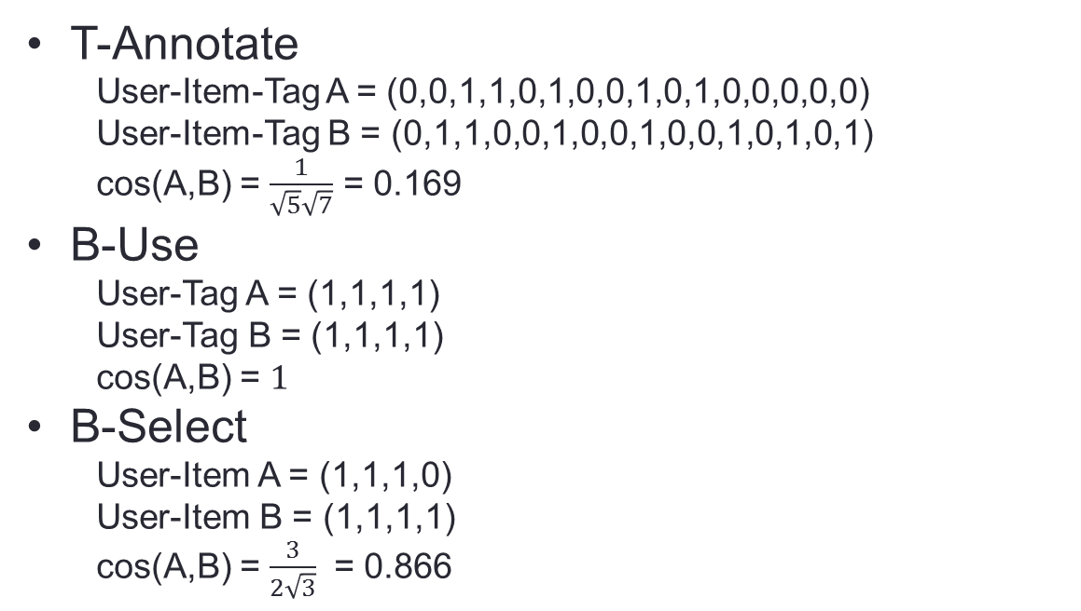
User A | T1 | T2 | T3 | T4
I1 | 0 | 0 | 1 | 1
I2 | 1 | 0 | 0 | 0
I3 | 0 | 1 | 1 | 0
I4 | 0 | 0 | 0 | 0
User B | T1 | T2 | T3 | T4
I1 | 0 | 1 | 1 | 0
I2 | 0 | 1 | 0 | 0
I3 | 1 | 0 | 0 | 1
I4 | 0 | 1 | 0 | 1
T-Annotate
User-Item-Tag A = (0,0,1,1,0,1,0,0,1,0,1,0,0,0,0,0)
User-Item-Tag B = (0,1,1,0,0,1,0,0,1,0,0,1,0,1,0,1)
cos(A,B) = $\frac{1}{\sqrt{5}\sqrt{7}}$ = 0.169
B-Use
User-Tag A = (1,1,1,1)
User-Tag B = (1,1,1,1)
cos(A,B) = $1$
B-Select
User-Item A = (1,1,1,0)
User-Item B = (1,1,1,1)
cos(A,B) = $\frac{3}{2\sqrt{3}}$ = 0.866

Slide 9
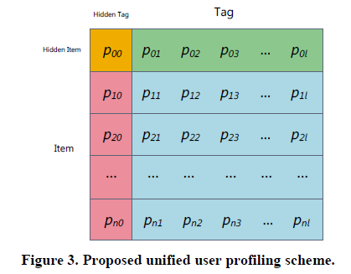
User A | T1 | T2 | T3 | T4
I1 | 0 | 0 | 1 | 1
I2 | 1 | 0 | 0 | 0
I3 | 0 | 1 | 1 | 0
I4 | 0 | 0 | 0 | 0
User B | T1 | T2 | T3 | T4
I1 | 0 | 1 | 1 | 0
I2 | 0 | 1 | 0 | 0
I3 | 1 | 0 | 0 | 1
I4 | 0 | 1 | 0 | 1
When the item is being saved, this Hidden Tag will be used automatically.
Users will be considered to be similar to a certain extent through the Hidden Tag once they have saved the same item, even if they have assigned completely different sets of tags to the item.
Laziness, use of non-descriptive tags for personal uses only, and spelling error.

Slide 10
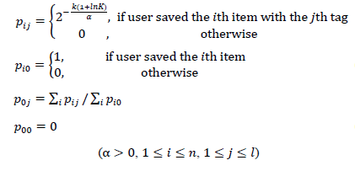
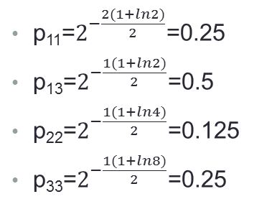
Weighting of User Profile Matrix
 | T1 | T2 | T3
I1 | 1 | 0 | 1
I2 | 0 | 1 | 0
I3 | 0 | 0 | 1
k : ranking index of the tag.
K : total number of tags.
𝛼 : empirical parameter.
k T1=3,T2=2,T3=1 , if they exist in the same item
K I1=2,I2=4,I3=8
𝛼 = 2
Tag
Hidden Tag
 | T0 | T1 | T2 | T3
I0 | 0 | 0.084 | 0.042 | 0.25
I1 | 1 | 0.25 | 0 | 0.5
I2 | 1 | 0 | 0.125 | 0
I3 | 1 | 0 | 0 | 0.25
p₁₁=$2^{−\frac{2(1+ln2)}{2}}$=0.25
p₁₃=$2^{−\frac{1(1+ln2)}{2}}$=0.5
p₂₂=$2^{−\frac{1(1+ln4)}{2}}$=0.125
p₃₃=$2^{−\frac{1(1+ln8)}{2}}$=0.25
p₀₁=0.25/3
p₀₂=0.125/3
p₀₃=0.75/3
Hidden Item
Item

Slide 11
Dimensionality Reduction
Profile matrix
It can be efficiently stored in a sparse form.
Calculating similarities → Time-consuming.
Solution : Latent Semantic Analysis
The lower dimensional representation of users is obtained
Compute the cosine similarity between users a and b
𝐅 : A user’s feature matrix in the item × tag subspace.
𝑓_{𝑖𝑗} : <i, j> entry of feature matrix.

Slide 12
Joint Item-Tag Recommendation
Problem Definition
From Joint Recommendation to Item Recommendation

Slide 13
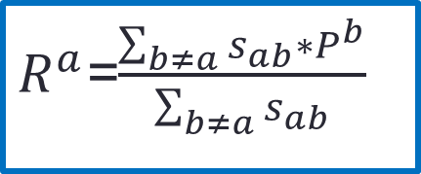
Problem Definition
Propose to recommend a joint item-tag matrix to each user , with the tags representing the topics of the target item that might attract the user.
$R^{a}$=$\frac{\sum_{b≠a}{s_{ab}∗P^{b}}}{\sum_{b≠a}{s_{ab}}}$
𝐑ª : the recommended profile matrix for user a.
𝑠_{𝑎𝑏} : the similarity between users a and b, sim(Fª ,F^{b} )
𝐏^{b} : the profile matrix (not feature matrix) of user b.
Users Profile matrix
a Pª
b P^{b}
c P^{c}
d P^{d}
e P^{e}
Similarity
S_{ab} = 0.5
S_{ac} = 0.4
S_{ad} = 0.3
S_{ae} = 0.6

Slide 14
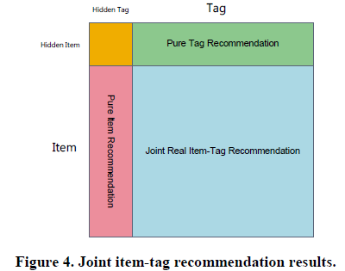
Problem Definition
The recommended profile matrix for each user consists of four blocks.
𝑝(𝑡)^{𝑝𝑢𝑟𝑒} : Tag t in the Hidden Item Row of the recommended
(a user’s potential interest in tags.)
𝑝(𝑡)^{𝑖𝑛𝑖𝑡} : Initial profile matrices. (a user’s current interest in tags.)

Slide 15
From Joint Recommendation to Item Recommendation
Joint real item-tag recommendations explicitly consider a user’s possible interest in each item with respect to each tag (topic).
An intuitive solution would be generating a denser type of joint recommendations based on the two denser pure recommendations and then fuse it with the joint real item-tag recommendation.
(B-Associated information )

Slide 16
From Joint Recommendation to Item Recommendation
The final joint item-tag recommendation result can then be computed as a weighted average of the two joint recommendations.
A refined item recommendation can be obtained by marginalizing the final joint recommendation result.

Slide 17
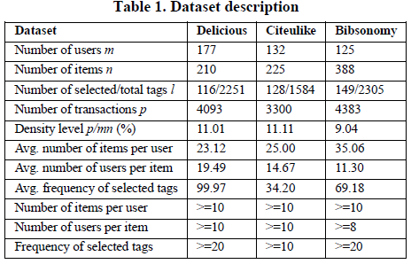
Experiment
Datasets
Delicious
CiteULike
Bibsonomy

Slide 18
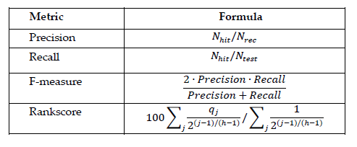
Evaluation Protocols and Metrics
N_{rec} : Total number of recommendations
N_{hit} : Number of correct recommendations
N_{test} : Number of items in the test set
𝑞_{𝑗} : j-th item is saved by user → 1
otherwise → 0
j : index of an item in the predicted ranked list
h : the viewing half-life of users
Example :
Dataset : 5000 data
500 item related to basketball
User gives a tag “basketball”, system retrieves 2000 data, 400 data related to basketball
Precision = 400/2000 = 0.2
Recall = 400/500 = 0.8
F-measure = $\frac{2∗0.2∗0.8}{0.2+0.8}$ = 0.32

Slide 19
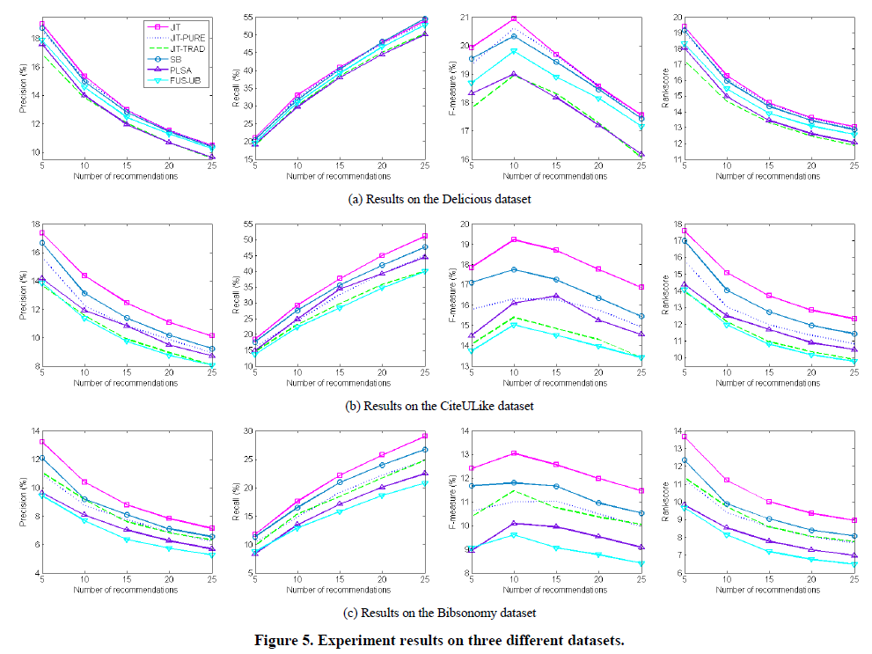
Results

Slide 20
Sensitivity Analysis
Gain a truthful representation of a user’s interest in tags
𝜆 = 0.5
𝜆 = 0.7
𝜆 = 0.6
It’s very stable when 𝜇 approach 1
𝜇 = 0.4
𝜇 = 0.8
𝜇 = 1.0

Slide 21
Conclusion
Joint item-tag recommendation framework is able to utilize complete information in the tagging data, to produce high-quality item recommendations.
Find some theoretical foundations for the unified user profiling scheme and to develop more systematic weighting methods for it.
Explore effective alternative approaches to measuring the association between items and tags.

Slide 22
Thanks for your listening

Slide 23
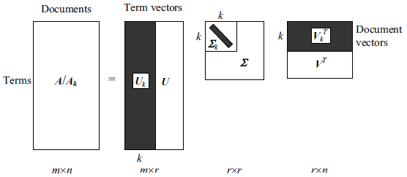
Latent Semantic Analysis
LSA( 隱含語意分析)
是以統計的方式去解析某個字詞在文件間的接近程度, 使用LSA來分析而成的索引就是LSI(Latent Semantic Indexing)
SVD(Singular Value Decomposition)
LSI 對SVD 做了一點改變，就是對Ʃ的r 個對角線元素進行了排序，並只保留前k 個值( k < r )， 後面r - k 個設0。

Slide 24
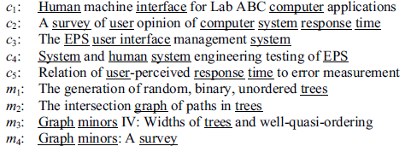
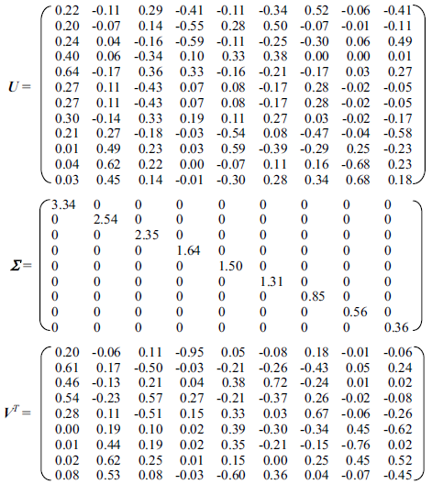
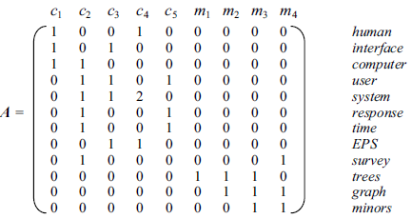
Singular Value Decomposition

Slide 25
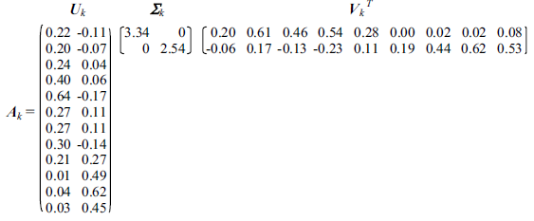
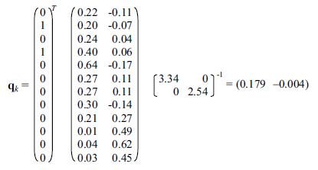
, k=2
q_{k} is then compared with every document vector in V_{k} using the cosine similarity.
query q = “user interface”

